Slide 1
SiamCAR: Siamese Fully Convolutional Classification and Regression for Visual Tracking Dongyan Guo, Jun Wang, Ying Cui∗, Zhenhua Wang, Shengyong Chen College of Computer Science and Technology Zhejiang University of Technology, Hangzhou 310023, China
Published in CVPR 2020
Presented by:
Md. Maklachur Rahman School of Computer Science and Engineering
Kyungpook National University
Republic of Korea

Slide 2
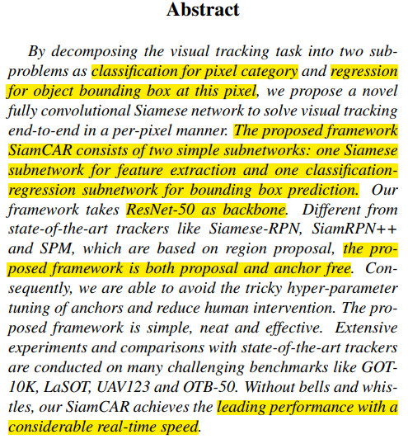
Abstract
The proposed framework SiamCAR consists of two simple subnetworks: one is Siamese subnetwork for feature extraction and another one is classification regression subnetwork for bounding box prediction.
They use ResNet-50 as the backbone of Siamese architecture.
Different from Siamese-RPN and SiamRPN++, this proposed framework is both proposal and anchor free.
They perform extensive experiments on GOT-10K, LaSOT, UAV123 and OTB-50 and achieve leading performance with a considerable real-time speed.

Slide 3
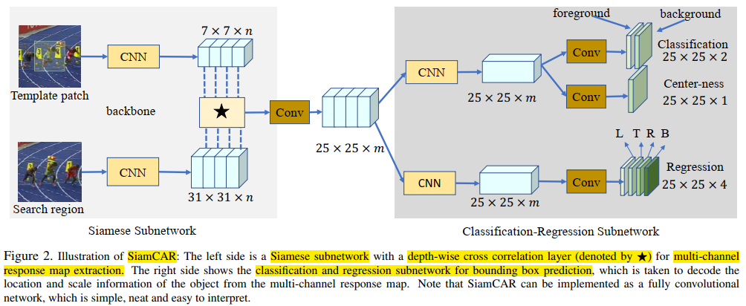
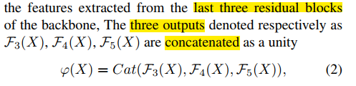
Tracker architecture

Slide 4
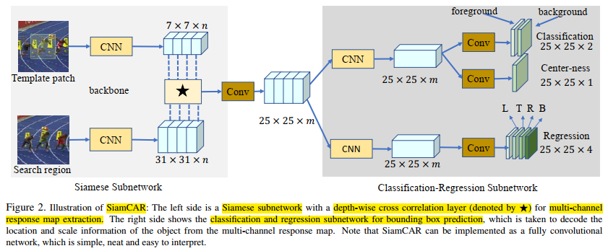
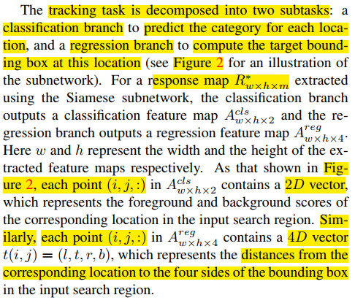
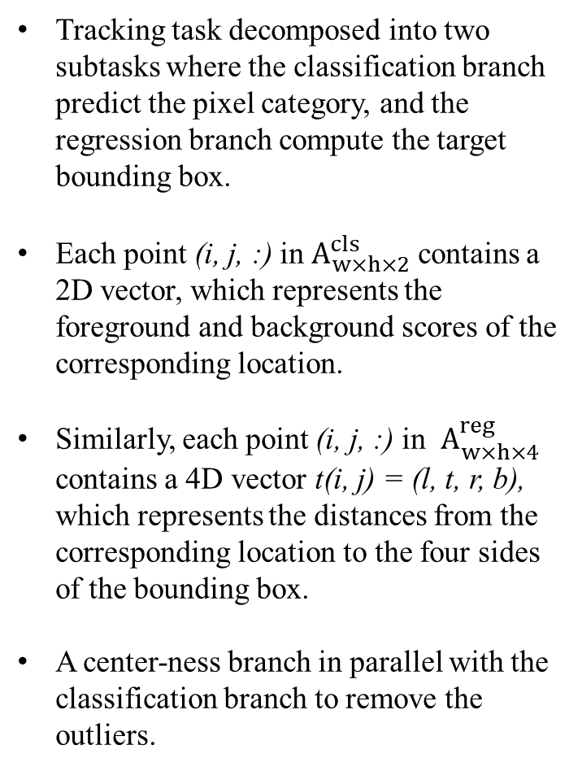
Tracker architecture
Tracking task decomposed into two subtasks where the classification branch predict the pixel category, and the regression branch compute the target bounding box.
Each point (i, j, :) in $A_{w×h×2}^{cls}$ contains a 2D vector, which represents the foreground and background scores of the corresponding location.
Similarly, each point (i, j, :) in $A_{w×h×4}^{reg}$ contains a 4D vector t(i, j) = (l, t, r, b), which represents the distances from the corresponding location to the four sides of the bounding box.
A center-ness branch in parallel with the classification branch to remove the outliers.

Slide 5
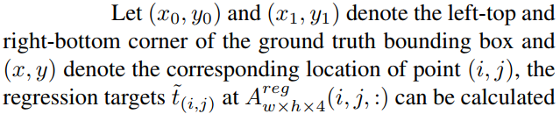
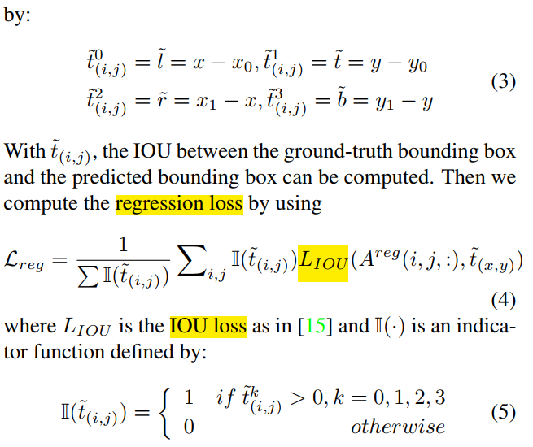
Regression loss for training

Slide 6
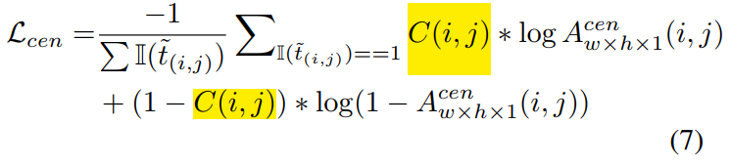
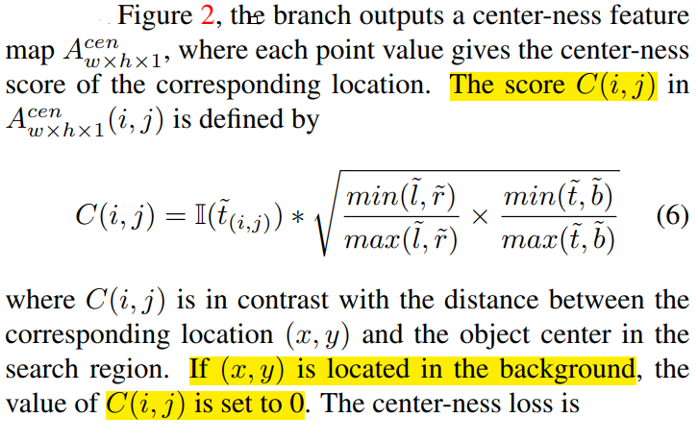
Center-ness loss for training
Low quality bounding boxes that are far away from the center of the object consider as outliers that degrade the tracking performance.
To suppress this low-quality detected bounding boxes, they introduce center-ness loss function.

Slide 7
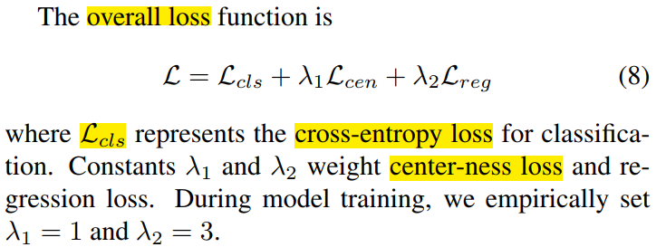
Overall loss for training

Slide 8
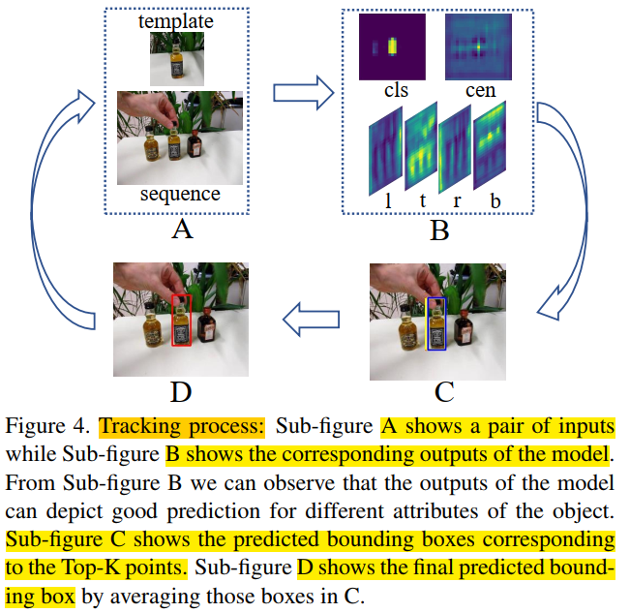

Testing phase
To predict the location in the current frame, they consider
To handle the scale change, we penalize the classification score with Pij. Then theupdated scores will be PT_{ij} = (cls_{ij} × p_{ij} , cen, l, t, r, b).
The height penalize score consider the target location.

Slide 9
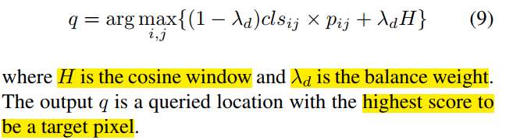
Testing phase
Then the tracking phase can be formulated as:
Since this model solves the object tracking with a per-pixel prediction manner, each location is relative to a predicted bounding box.
They observed that the pixels located around q are more likely to be the target pixel.
They choose the top-k points from n neighborhoods of q according to the value cls_{ij} × p_{ij .}
The final prediction is the weighted average of the selected k regression boxes.

Slide 10
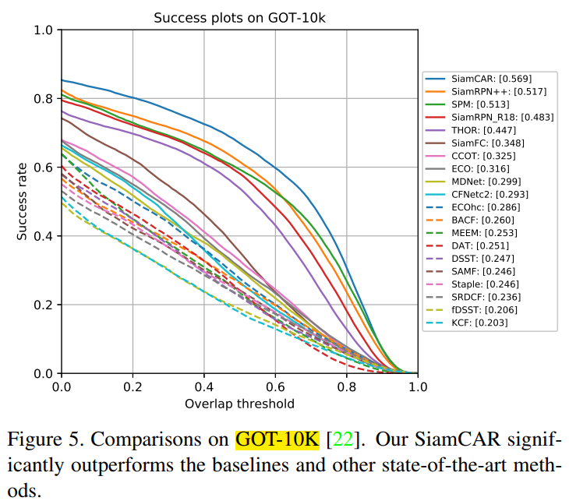
Experimental results on GOT-10K

Slide 11
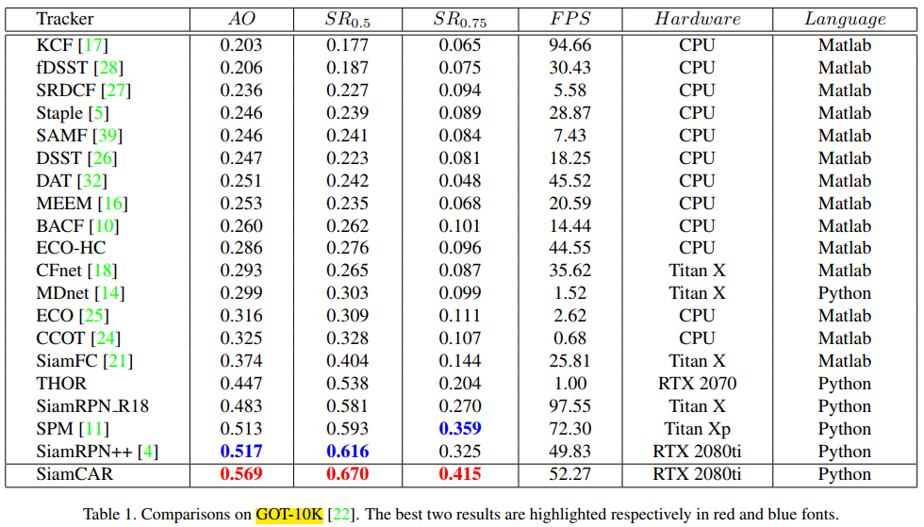
Experimental results on GOT-10K

Slide 12
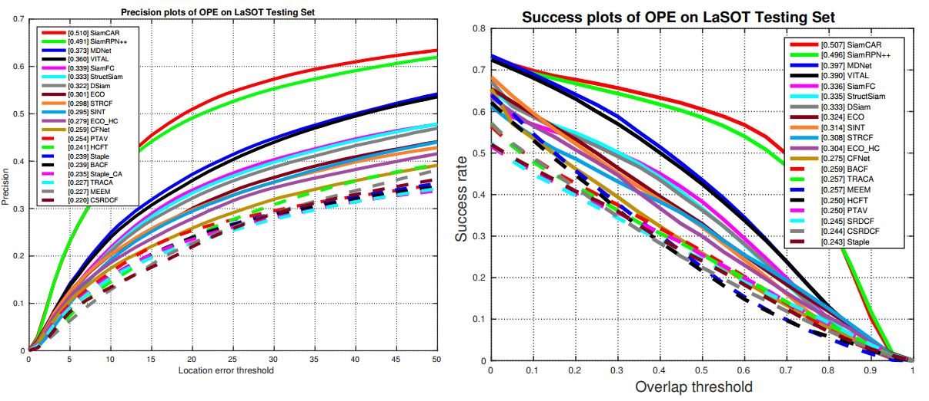
Experimental results on LaSOT benchmark
Figure 6. Comparisons among Top-20 trackers on LaSOT benchmark.

Slide 13
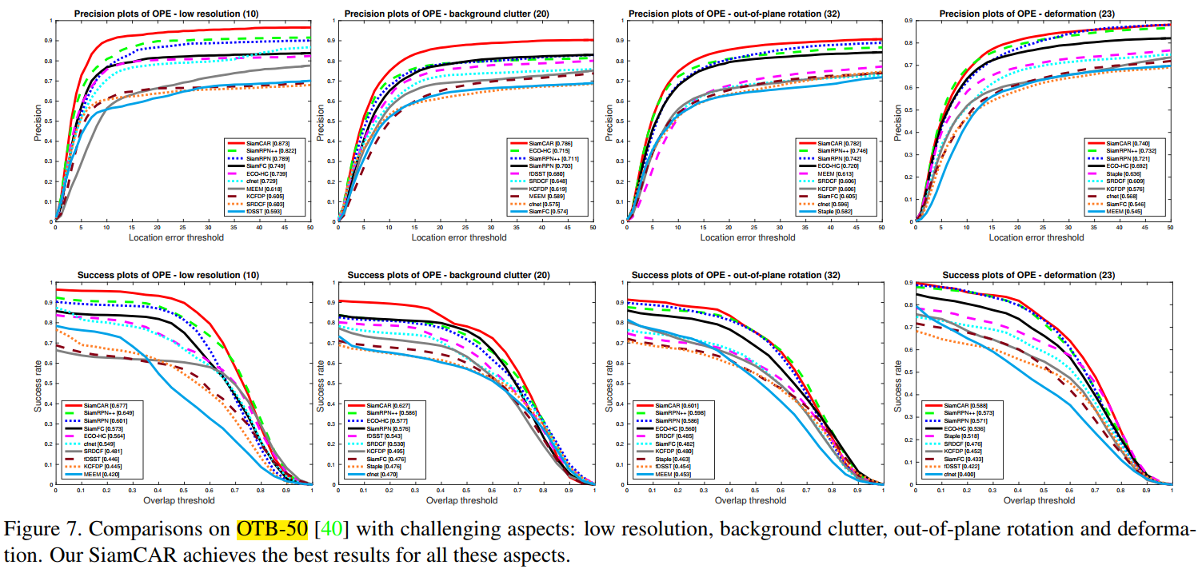
Experimental results on OTB-50 different challenges

Slide 14
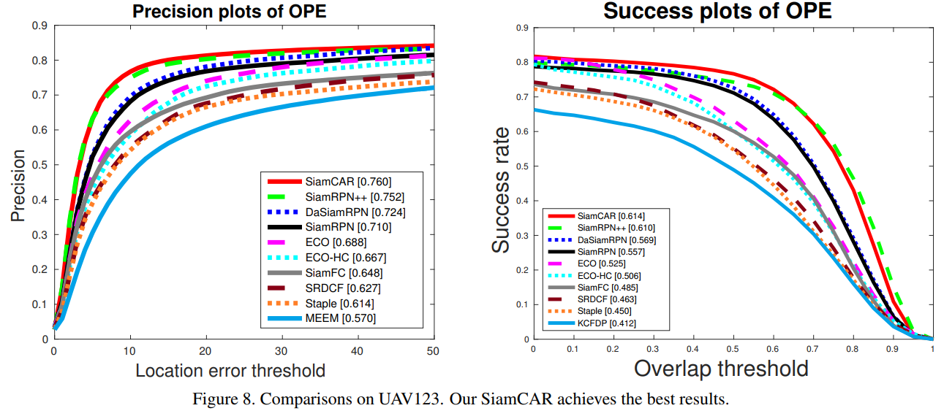
Experimental results on UAV123 dataset

Slide 15
Conclusion
They show that the tracking task can be solved in a per-pixel manner.
This proposed framework is very simple in structure but achieves state-of-the-art results.
It also achieves state-of-the-art results on large dataset such as LaSOT, which demonstrate the generalizability of our SiamCAR

Slide 16
감사합니다 (Thank you) Q&A

